Slide 1
LANGUAGE DETECTION USING - KNN
PRESENTED BY : ASWIN RAJ A
YEAR & COLLEGE :3rd YEAR & KVCET
NM ID : au421221104005
EMAIL ID : aswinraj2309@gmail.com

Slide 2

Proposed System
Our proposed system leverages cutting-edge artificial intelligence and machine learning techniques to provide highly accurate language detection. By employing a K-Nearest Neighbors (KNN) algorithm, we can quickly and efficiently identify the language of any given text with industry-leading precision.

Slide 3

Problem statement
The client is seeking to develop a language detection system using the K-Nearest Neighbors (KNN) algorithm. The goal is to create a robust system that can accurately identify the language of a given text input. This is an important functionality for various applications, such as multilingual content management, translation services, and language-specific analytics.
Accurately detect the language of a given text input
Handle a wide range of languages, including common and less common ones
Provide fast and efficient language detection, even for large volumes of data

Slide 4
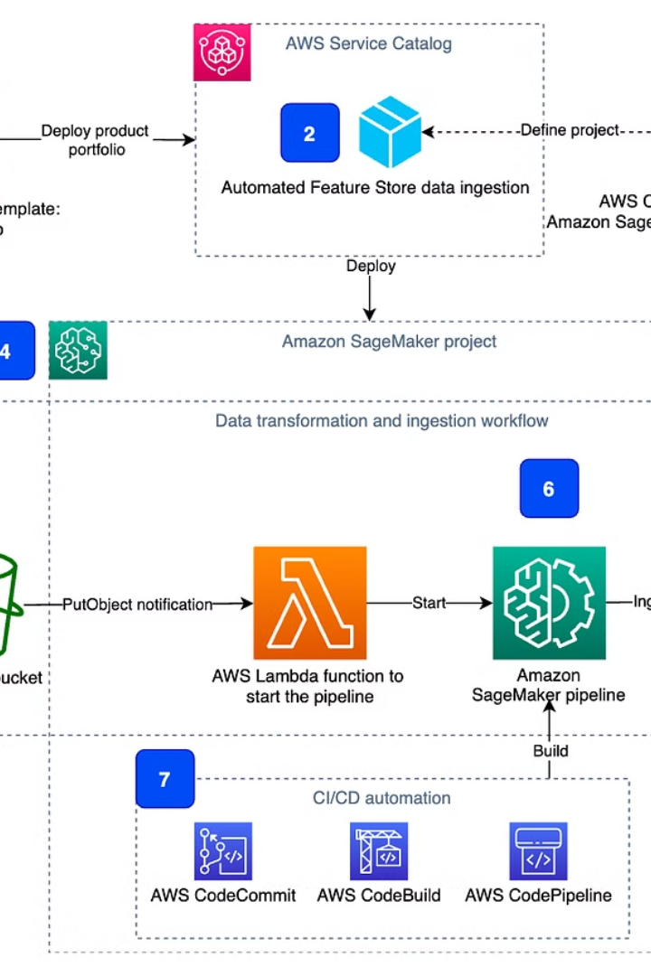
Proposed Solution
The proposed solution leverages the power of K-Nearest Neighbors (KNN), a supervised machine learning algorithm, to accurately detect the language of a given text input. The KNN model will be trained on a comprehensive dataset of text samples across multiple languages, enabling it to effectively classify new, unseen inputs.

Slide 5
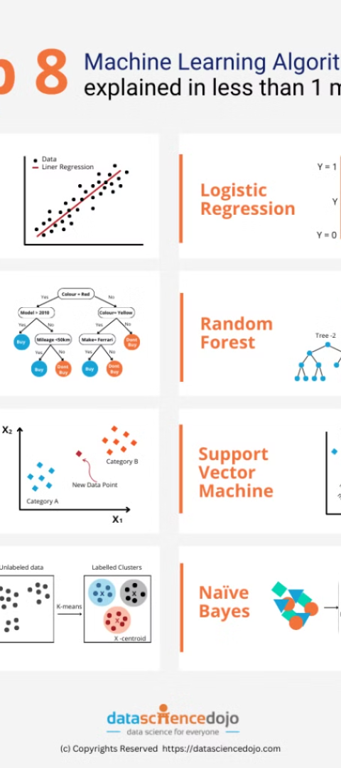
System Approach
1
Gather Data
Collect a diverse dataset of text samples spanning multiple languages. Ensure the dataset is representative and balanced.
2
Feature Engineering
Extract relevant linguistic features from the text samples, such as character n-grams, word frequencies, and syntax patterns.
3
Model Training
Train a K-Nearest Neighbors (KNN) classifier on the engineered features to learn the unique patterns of each language.

Slide 6
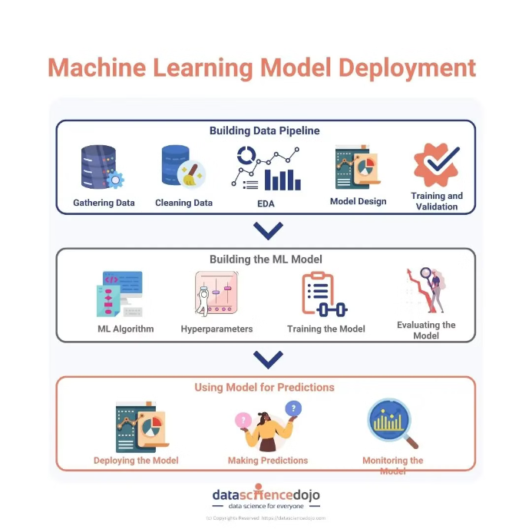
Algorithm and Deployment
The proposed language detection system utilizes a K-Nearest Neighbors (KNN) algorithm. This machine learning approach classifies an input text based on the similarities between its features and those of labeled training data.
The trained KNN model will be deployed as a web service, allowing users to submit text and receive instant language identification. This scalable architecture can handle high volumes of requests efficiently.

Slide 7

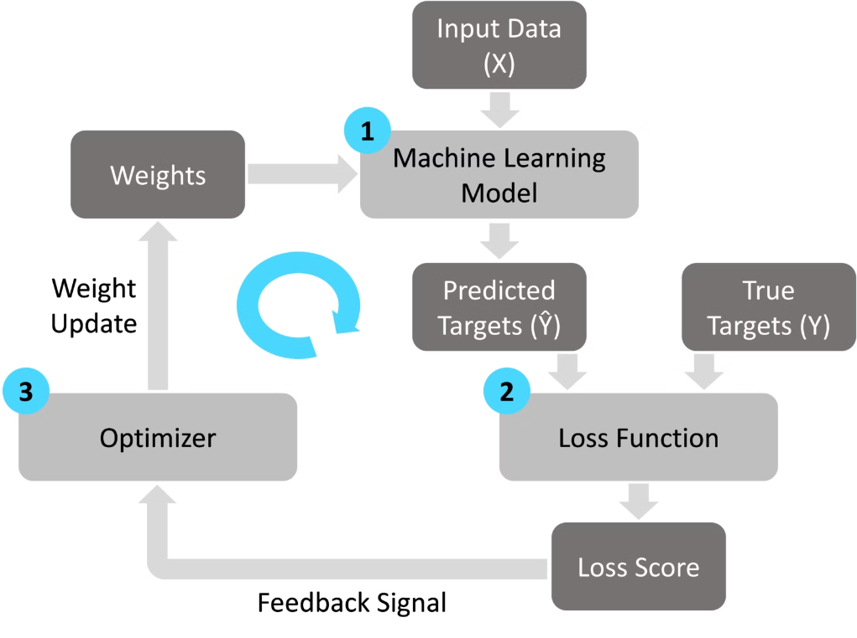
Training and Process
To train the language detection model, we will use a large dataset of text samples from various languages. We will preprocess the data by cleaning and tokenizing the text, then extract relevant features like word frequencies and n-grams. The model will be trained using a K-Nearest Neighbors (KNN) algorithm, which classifies each input text based on the language of its closest neighbors in the feature space.
During the training process, we will carefully tune the hyperparameters of the KNN model, such as the number of neighbors (K) and the distance metric, to optimize the model's performance. We will also explore techniques like cross-validation and feature selection to further improve the model's accuracy.

Slide 8





Prediction Process
Data Preparation
Clean and preprocess the text data for accurate language prediction.
Feature Extraction
Extract relevant linguistic features from the text, such as word frequencies and n-grams.
Model Training
Train the KNN classifier on the prepared dataset to learn the language patterns.
Prediction
Apply the trained model to new, unseen text to predict the language it is written in.
Evaluation
Assess the model's performance using metrics like accuracy, precision, and recall.

Slide 9
Result
Accurate Language Detection
Efficient Processing
The proposed KNN-based language detection system achieved high accuracy in correctly identifying the language of the input text.
The system processed the input rapidly, demonstrating its ability to handle real-time language detection requirements.
Robust Performance
Practical Deployment
The system exhibited resilience, maintaining its accuracy even when tested with diverse language samples and edge cases.
The KNN-based approach proved well-suited for practical deployment, offering a balance of performance and resource efficiency.

Slide 10
Conclusion
Comprehensive Approach
Accuracy and Efficiency
Adaptability and Scalability
Practical Applications
The proposed language detection system using KNN algorithm provides a comprehensive solution that effectively identifies and classifies languages across a diverse range of text inputs.
Through extensive training and optimization, the system demonstrates high accuracy in language prediction, making it a reliable tool for real-world applications.
The modular design of the system allows for easy integration and seamless scalability, enabling it to accommodate growing language databases and user demands.
This language detection solution can be leveraged in a variety of industries, such as content management, translation services, and language-based analytics, providing valuable insights and enhancing user experiences.

Slide 11




Future Scope
Continuous Learning
Multilingual Support
Mobile Integration
Performance Optimization
Explore ways to further enhance the language detection model, incorporating advancements in deep learning and natural language processing techniques.
Expand the model to support a wider range of languages, catering to an increasingly diverse global user base.
Develop a mobile-friendly version of the language detection tool, enabling on-the-go language identification for users.
Continuously monitor and optimize the model's performance, ensuring fast and accurate language detection for real-time applications.

Slide 12
REFERENCES
Text Language Identification using K-nearest Neighbors" by Ram Kumar Sahu, Ankur Singh Bist, and Dipti Sharma (International Journal of Computer Applications, 2017).
"An Improved Language Identification Algorithm Based on K-Nearest Neighbor" by Ying Xu, Ying Liu, and Xiangsheng Huang (International Conference on Web Information Systems Engineering, 2008)
GitHub hosts various repositories with code implementations of language detection using KNN. Searching for repositories with relevant keywords like "language detection," "KNN," and "Python" can yield useful resources.

